Slide 1
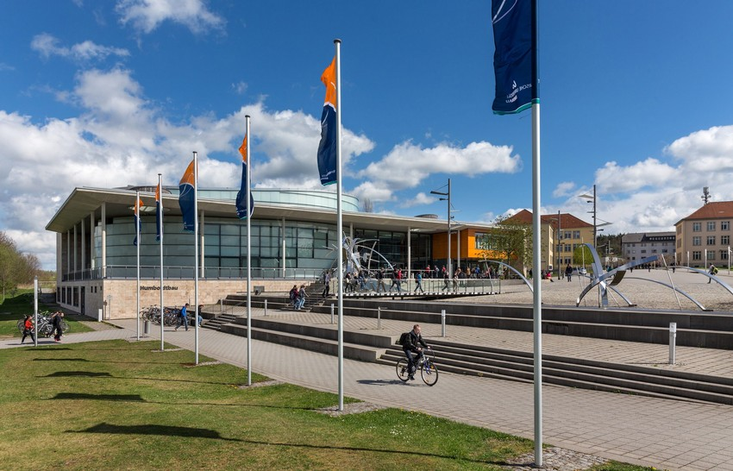
Technische Universität Ilmenau
W E L C O M E
Foto: © Michael Reichel

Slide 2
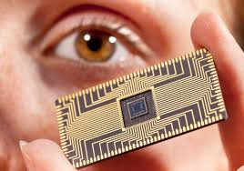
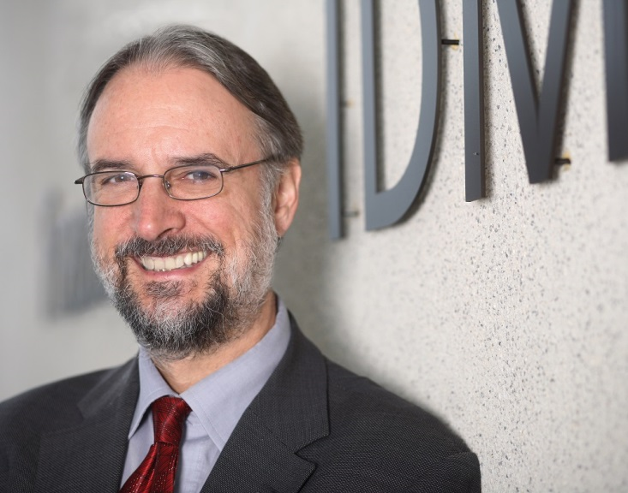

Slide 3
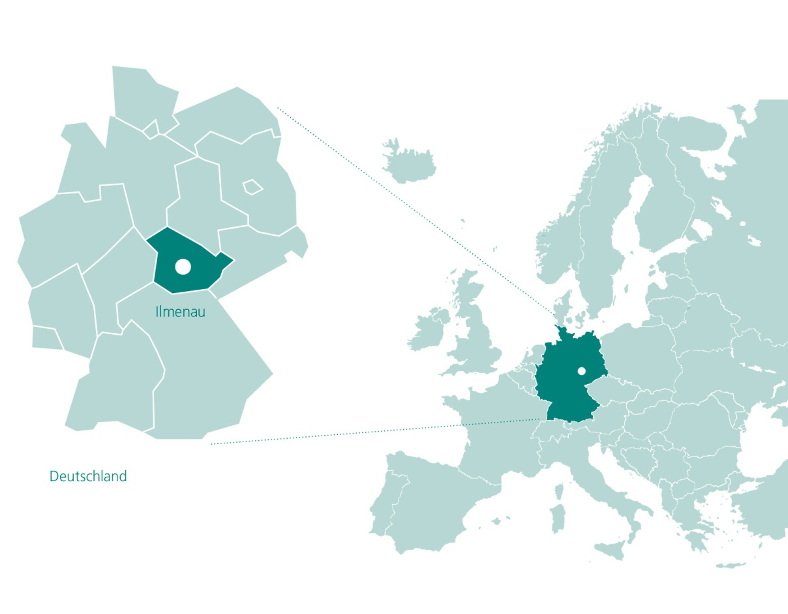
Where are we?

Slide 4
The City of Ilmenau
62,64 km²
32.000 inhabitants, incl. 6.500 students
www.ilmenau.de
maps.google.de

Slide 5
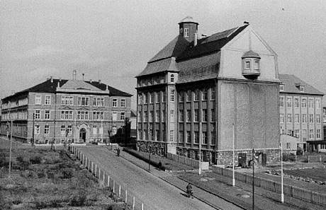
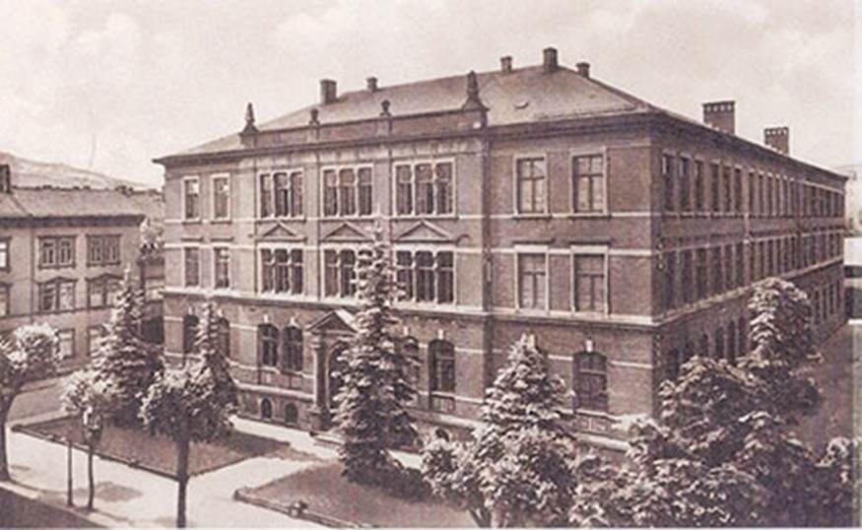
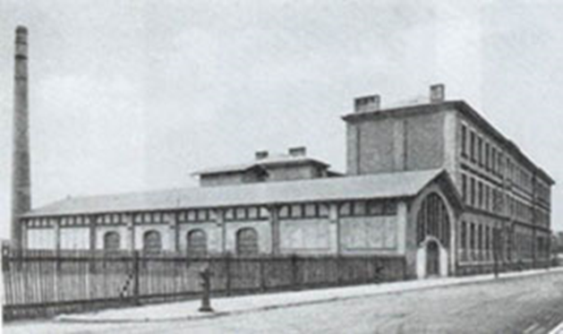
Thüringisches Technikum Ilmenau
The beginnings 1894

Slide 6
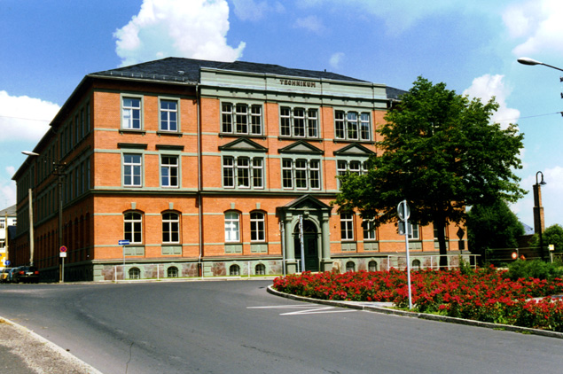
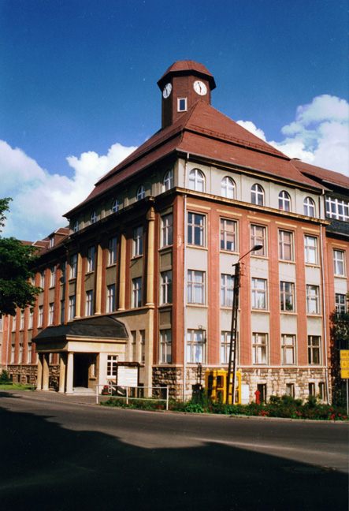
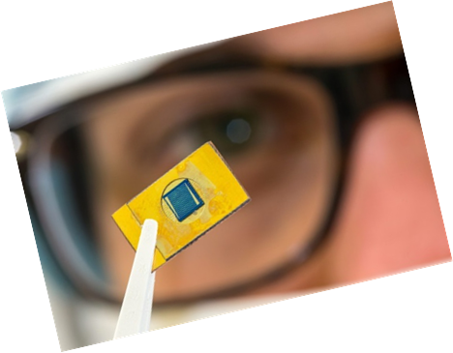
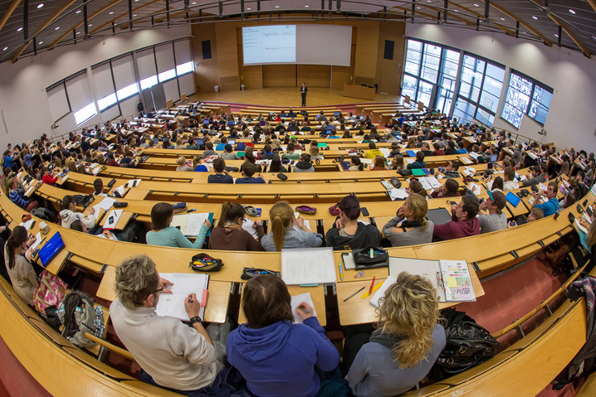
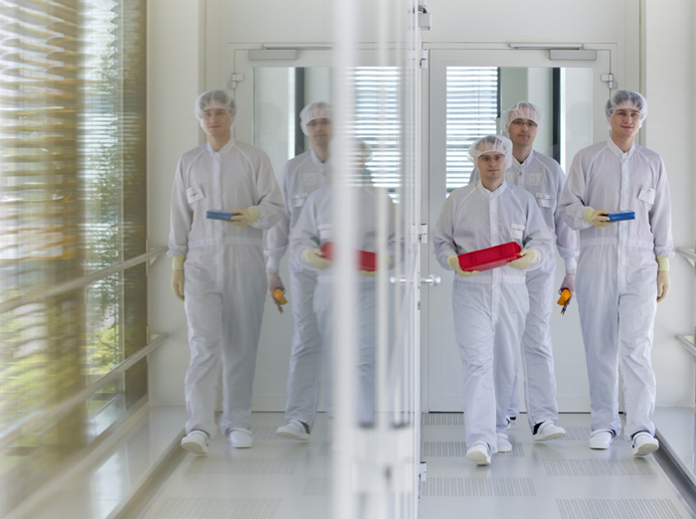
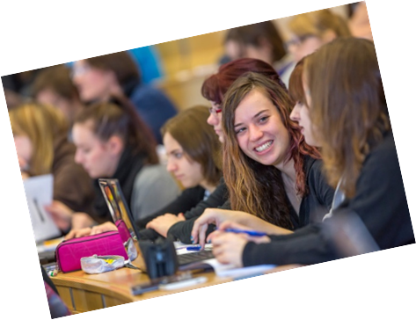
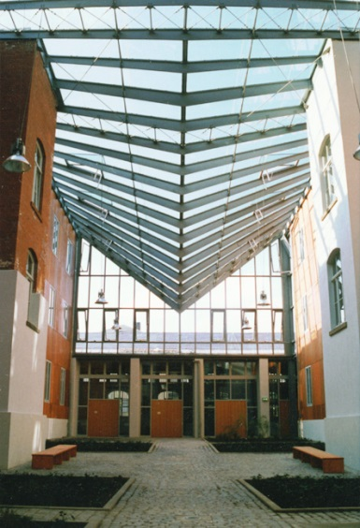
Technische Universität Ilmenau
Today
Curiebau
Faradaybau
Fotos: © TU Ilmenau

Slide 7
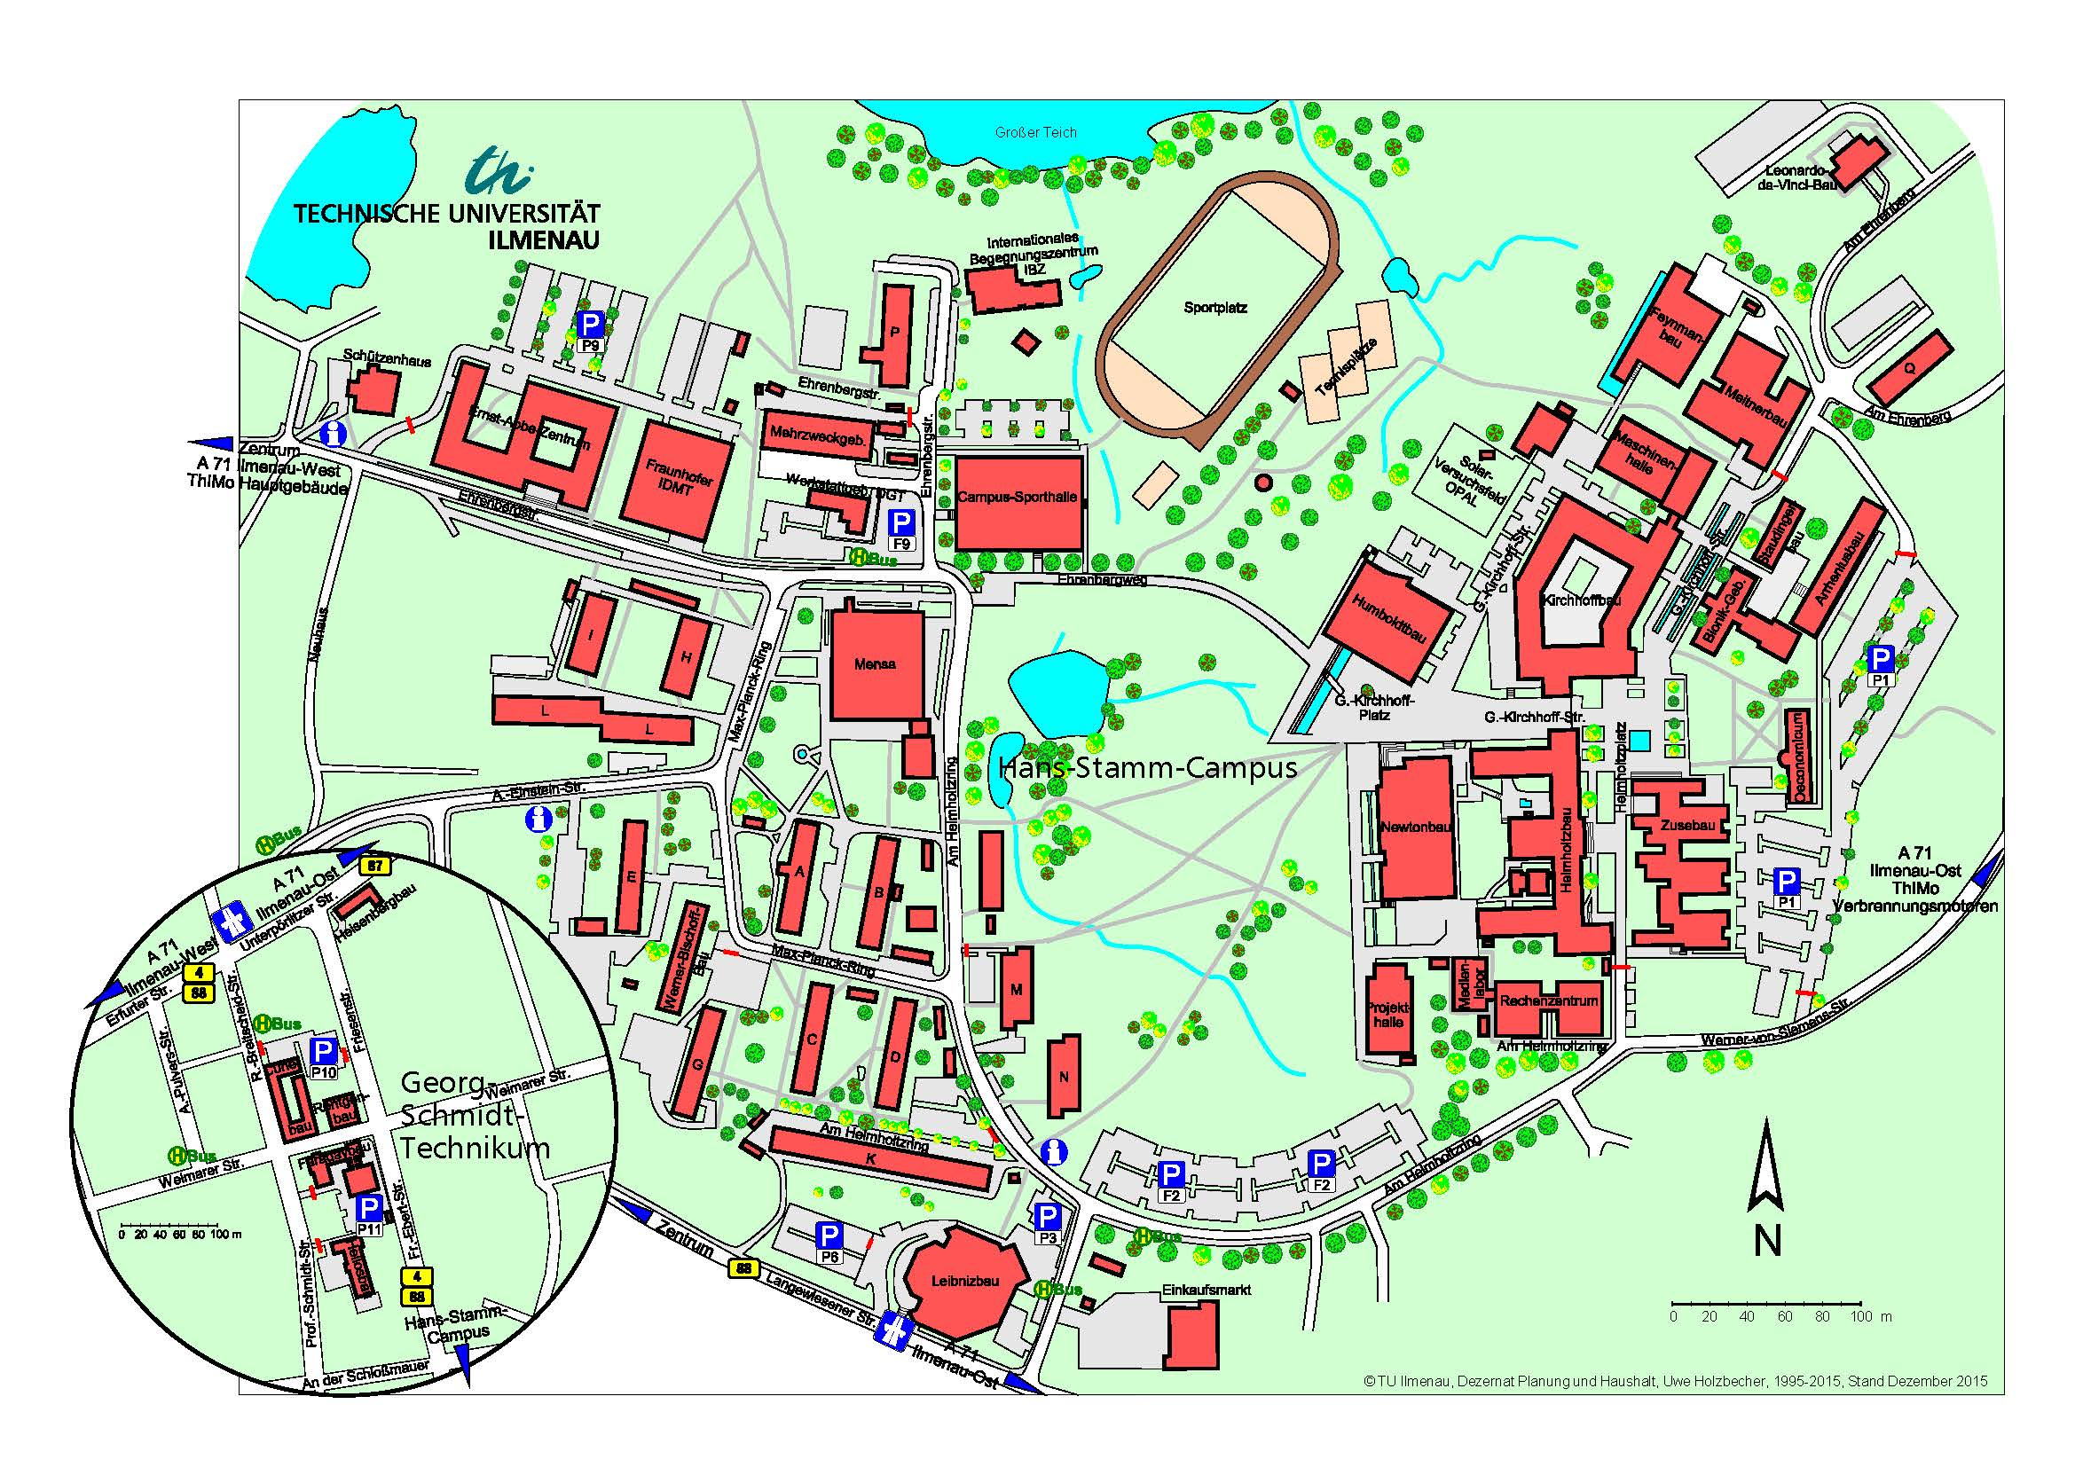

Slide 8
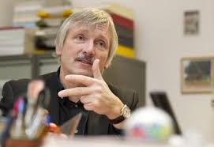
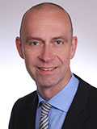
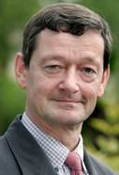
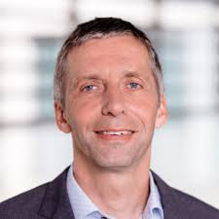
Who is who?
our President: Prof. Peter Scharff
Vice President for Teaching: Prof. Jürgen Petzoldt
Director of Administration and Finance: Dennys Klein
Vice President for Research: Prof. Kai-Uwe Sattler

Slide 9
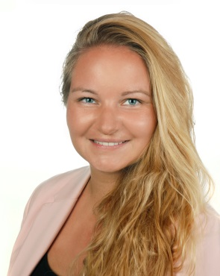
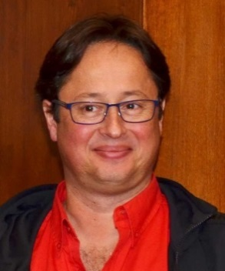
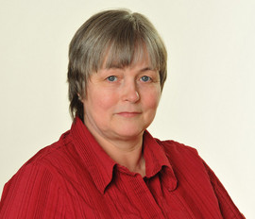
we4you
orientation week
welcome desk for international students
Buddy program for freshers
Tutoring programs (welcome tutors, language tutors, student hostel tutors, event tutors)
events during the semester, incl. excursions
International advisory servcie
Stephan Fischer
Beatrice Einecke
we4you@tu-ilmenau.de
Gudrun Breternitz

Slide 10
Technische Universität Ilmenau
S t a f f a n d S t u d e n t s
 Professors
University Professors 102
endowed Professors 10
junior professorship 8
 academic staff 500
 Staff funded from outside sources 400
 Students in WS 2016/17
Total 6,248
International students 1,239
Stand: 11/2016
Stand: 01.10.2007

Slide 11
Study programs
Engineering Sciences
Automotive Engineering
Biomedical Engineering
Chemical Biotechnology
Communications and Signal Processing
Computer and Systems Engineering
Electrical Engineering and Information Technology
Electrical Power and Control Engineering
Electrochemistry and Electroplating
Materials Science and Engineering
Mechanical Engineering
Mechatronics
Media Technology
Miniaturised Biotechnology
Optical Systems Technology/Optronics
Polyvalent Studies with Teaching Certification for Vocational Schools
Research in Computer and Systems Engineering
Technical Cybernetics and Systems Theory
Mathematics and Natural Sciences
Chemical Biotechnology
Computer Science
Mathematics
Mathematics and Business Mathematics
Micro- and Nanotechnologies
Renewable Energy Technology
Technical Physics
Business and Social Sciences
Media and Communications Science
Applied Media and Communications Studies
Industrial Engineering and Management
Information Systems Engineering
Media Economics

Slide 12
Double degree programs
 | Mechatronics/Micromechatronics | ENSMM - École Nationale Supérieure de Mécanique et des Microtechniques de Besançon, France masters level
 | Biomedical Engineering | University Teknologi Skudai Malaysia masters level
 | Materials Science and Engineering Mechatronics Mechanical Engineering Technical Cybernatics and System Theory | Pontificia Universidad Católica del Perú PUCP Lima masters level
 | Business Management and Media Economics, Business Information Systems Engineering | Saint Petersburg State University masters level
 | Biomedical Engineering Industrial Engineering and Management | Tongji University – Zheijang College China bachelors level
 | Computer Science | Transilvanian University Braşov, Romania masters level

Slide 13
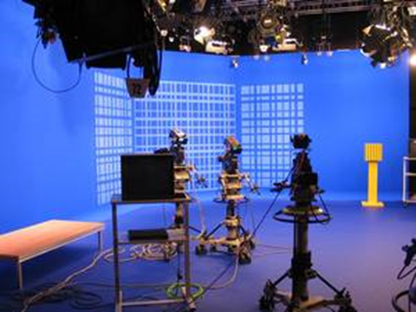
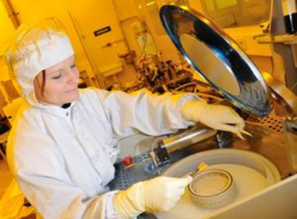
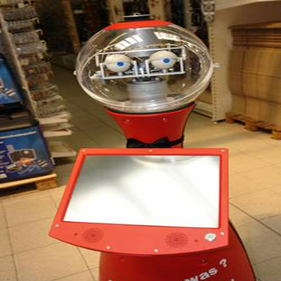
Research Clusters
Micro- and Nanosystems |  | Smart Systems Enginnering and IT
Nano-engineering | Precision Engineering & Precision Measurement Technology | Technical and Biomedical Assistance Systems | Drive, Energy & Environ-mental Systems Technology | Digital Media Technology | Mobile Commu-nications

Slide 14
Research profile

Slide 15
Functional materials & technologies: This profile line is based on interdisciplinary research work in development and application of functional materials and micro- and nanomaterials as well as by their targeted structuring. By means of micro- and nanointegration procedures, their usability in the macro world is guaranteed, e.g. for applications in sensor technology, electronic engineering, energy technology, communication technology or bio-systems technology. The micro- and nanointegration procedures already cover a wide range of bottom-up and top-down methods for production and structuring and comprehensive analytics.
Intelligent sensor technology and precision metrology: This line comprises the holistic research of nanopositioning and nanometrology, nanofabrication, intelligent process measurement technology, image processing and Lorentz force velocimetry. Other areas involve research and application of intelligent sensor technology and sensor networks in the automotive field, in mechatronics and bio-mechatronics, in production technology and factory automation.
Complex systems and data-intensive engineering: This line covers methods and techniques for the holistic development, production and use of complex technical systems and the analysis of their dissemination in and impact on economy and society. Concrete operational areas at the TU Ilmenau are in particular micro systems technology, digital media technology, software and automation technology and mobile communications. This also includes data-intensive methods of access to large databases and their evaluation as in the fields of measurement technology, sensor technology, medical technology, fluid engineering and social media communication.

Slide 16
Central Operation Units
Inter-departmental Center for Micro- and Nanotechnologies (ZMN)
Inter-departmental Center for Energy Technologies (ZET)
Inter-departmental Center for Automotive and Production Engineering (ZAP)
Central Institute for Education (incl. Language Institute) (ZIB)
University Computer Center
University Library
Thuringia‘s Patent Center (PATON)
University Athletic Complex
TU Ilmenau International School

Slide 17
we4you
orientation week
welcome desk for international students
Buddy program for freshers
Tutoring programs (welcome tutors, language tutors, student hostel tutors, departmental tutors)
events during the semester, incl. excursions
International Summer and Winter courses
Academic Preparation Course
Welcome Center
Academic Service Center (ASC)

Slide 18
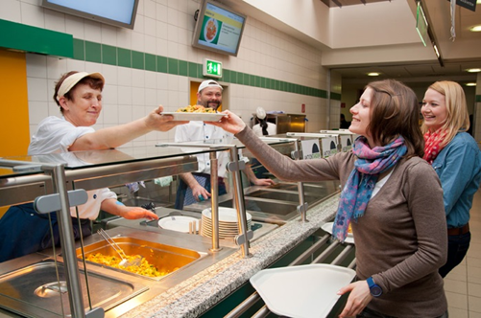
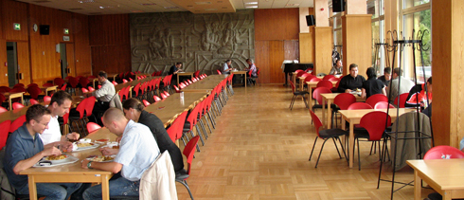
Studierendenwerk Thüringen
Students‘ dormitories
Students‘ cafeteria
Childrens day care
Cultural activities
Social counseling
… and much more

Slide 19
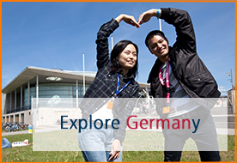
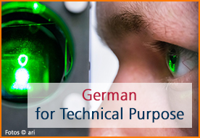
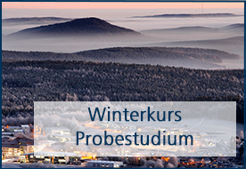
International Course – German Language

Slide 20
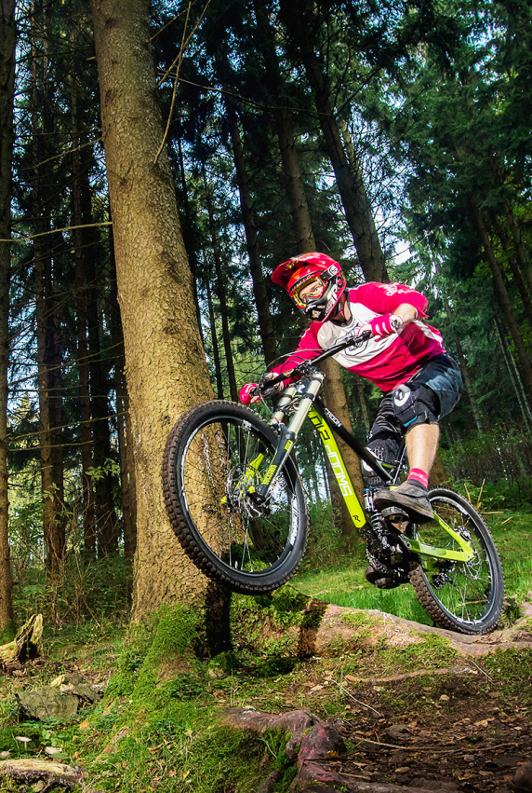
Sports
University Athletic Complex (more than 80 sports!)
Martial Arts
Fitness
Individual sports
Natural sports
Aqua sports
Team sports
Equitation
Dance
Field trips (Skiing etc.)
Sports clubs
… and more

Slide 21
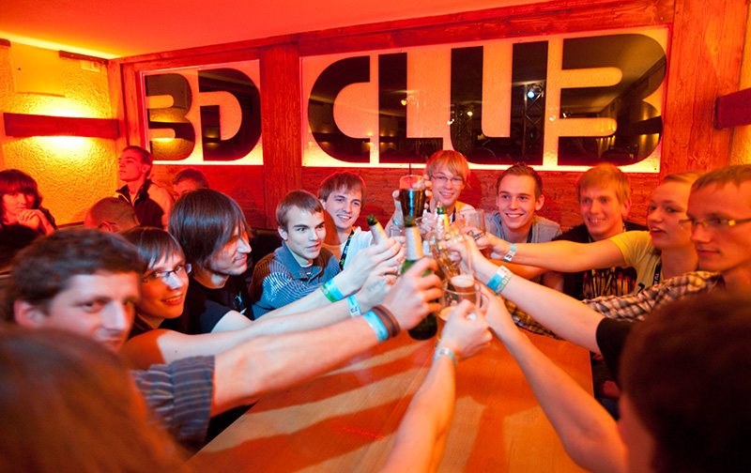
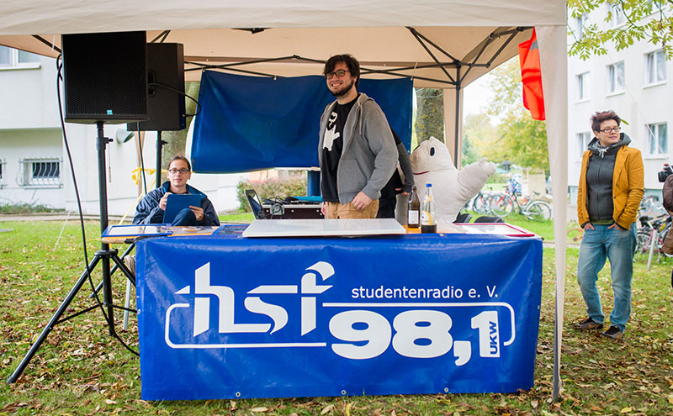
Cultural activities on campus
„Initiative for World Solidarity” Ilmenau (ISWI)
KuKo e.V. (pottery workshop, theater,…)
Chamber choir
Chamber orchestra
iSTUFF student television
Ilmenau student clubs
Student radio station hsf
Jazz club Ilmenau
Big Band Second Unit Jazz
Debating club
… and much more
also: clubs in the city of Ilmenau as fighting sports club, choirs… www.ilmenau.de

Slide 22
Beyond Studying
Be ...
interactive
international
interdisciplinary
ambitious
tu-ilmenau.de

Slide 23
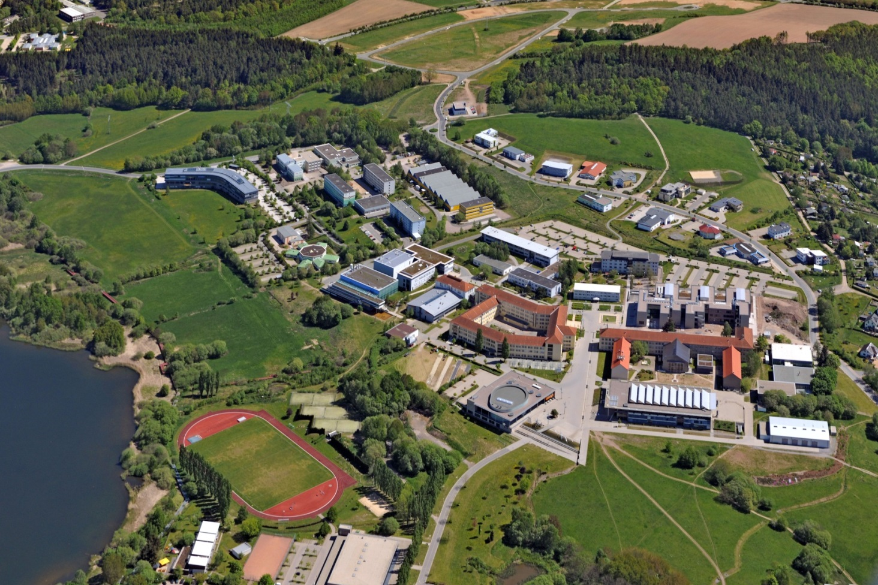
Technische Universität Ilmenau
We wish you a happy and successful life in Ilmenau,
full of good impressions
Luftaufnahme: © Nürnberg Luftbild, Hajo Dietz

Slide 24
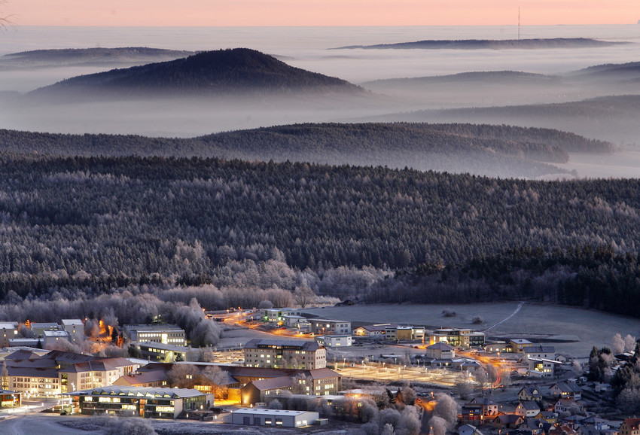
Technische Universität Ilmenau
T H A N K Y O U

